Slide 1


READCYCLING
WEEK

Slide 2

READCYCLING
WEEK
Donate 1 Book and £1 to fund its journey to Africa

Slide 3



READCYCLING
WEEK
Books2Africa is a UK-registered charity (1152599) founded in 2012. Our mission is to promote a culture of ‘readcycling’ and improve the quality of education in Africa, through the collection, processing, shipping and distribution of quality books, computers and educational materials that equip individuals, institutions, and communities to acquire knowledge and achieve their full potential in a globalised world.
Who are we?

Slide 4
READCYCLING
WEEK
At Books2Africa, 'readcycling' means giving new life to educational materials, preventing perfectly usable books and computers from ending up in UK recycling/landfill sites. At the same time, empowers people in Africa through knowledge and education.
Readcycling Week is the perfect opportunity to engage your workplace/school/college/university/community in this mission. Cultivate sustainability and improve the quality of education in Africa.
Why ‘Readcycling’?
At least 13 million books are thrown away and go to landfill in the UK every year.¹
While 90% (202 million) of children who attend school in Africa cannot read or write proficiently after finishing school in part because of lack books and educational resources.²
¹according to conservative estimates by CODEP
²According to UNESCO’s and The World Bank’s latest reports

Slide 5



READCYCLING
Sign up
WEEK
Complete our sign-up form.
Download & print the Welcome Pack(including posters, flyers and all the information you need) to start spreading the word.
How does it work?
Collect books & raise funds
Have a designated drop-off point for books and a fundraising bucket for people to donate. Use cardboard boxes to package all items collected ready for collection.
Ship items & track your impact
Contact us to arrange a collection and get a booking reference number to write on your boxes. You'll get an email when your books are shipped and a picture of the recipient when delivered.

Slide 6

READCYCLING
WEEK
  New or Used books
  Written in English, French or any African language
  Nursery, Primary, Secondary and University textbooks
  Dictionaries, Encyclopaedias and Reference books
  Novels, Hobbies and Leisure books
  Bibles, Hymnals and Religious books
  Unused Notebooks, Exercise books and stationery
  Ex library or charity shop books
  Comics
Types of Books We Accept
  No damaged or illegible books
  No folders, ring-binders or photocopied materials
  No brochures, pamphlets or lecture notes
  No pornography

Slide 7
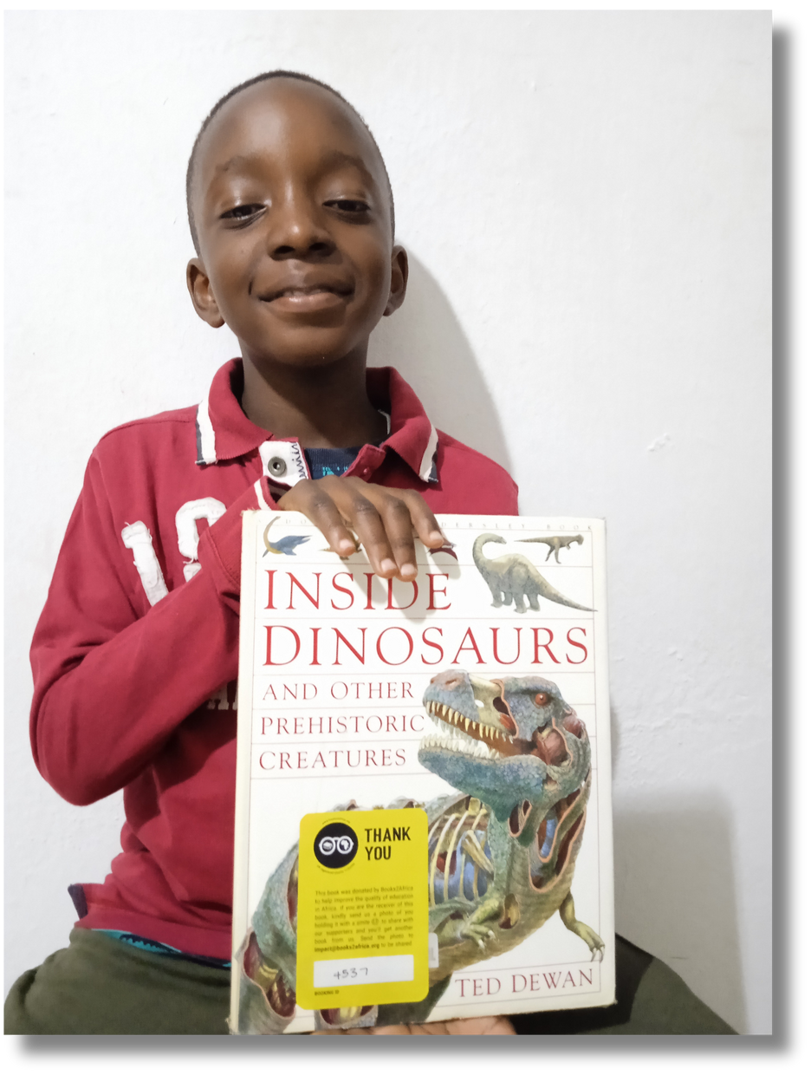
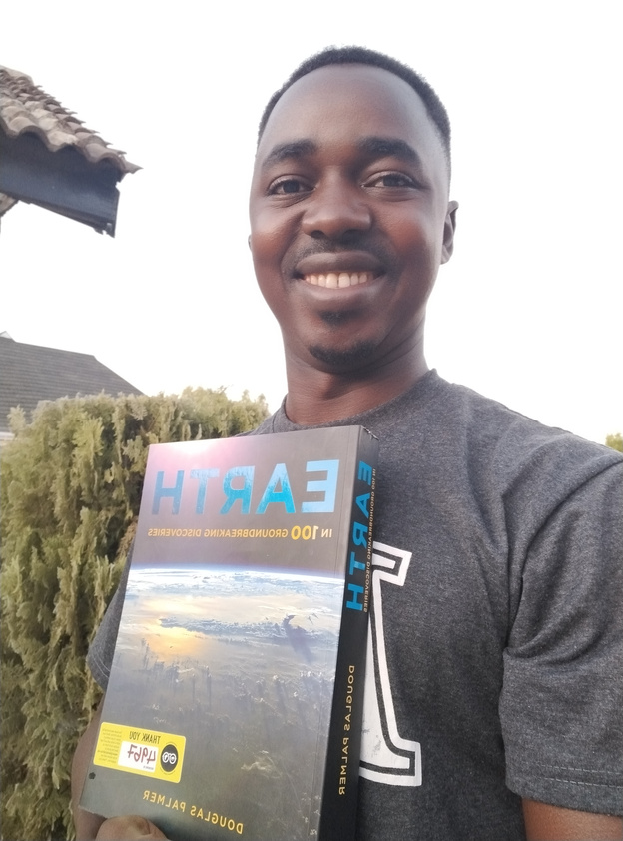
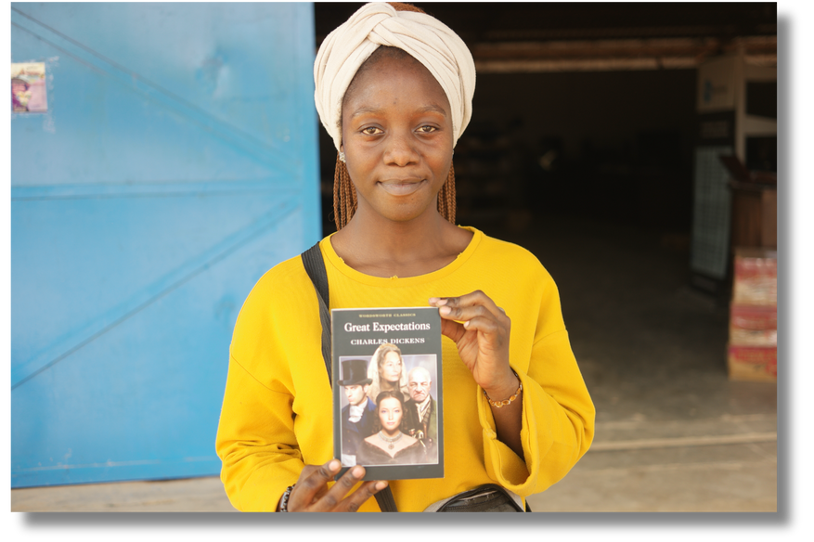
READCYCLING
WEEK
Real-time impact
Tracking the journey of your books
Track your books via our Impact Portal using your booking reference. We’ll also send you email updates at different stages of your book’s journey.
Magical yellow sticker
We put ‘magical’ yellow impact stickers on some of your books! It helps us to send you back pictures of the beneficiary who received the book in Africa.

Slide 8

Let’s start readcycling together!
www.books2africa.org/readcycling/

